Slide 1


Slide 2
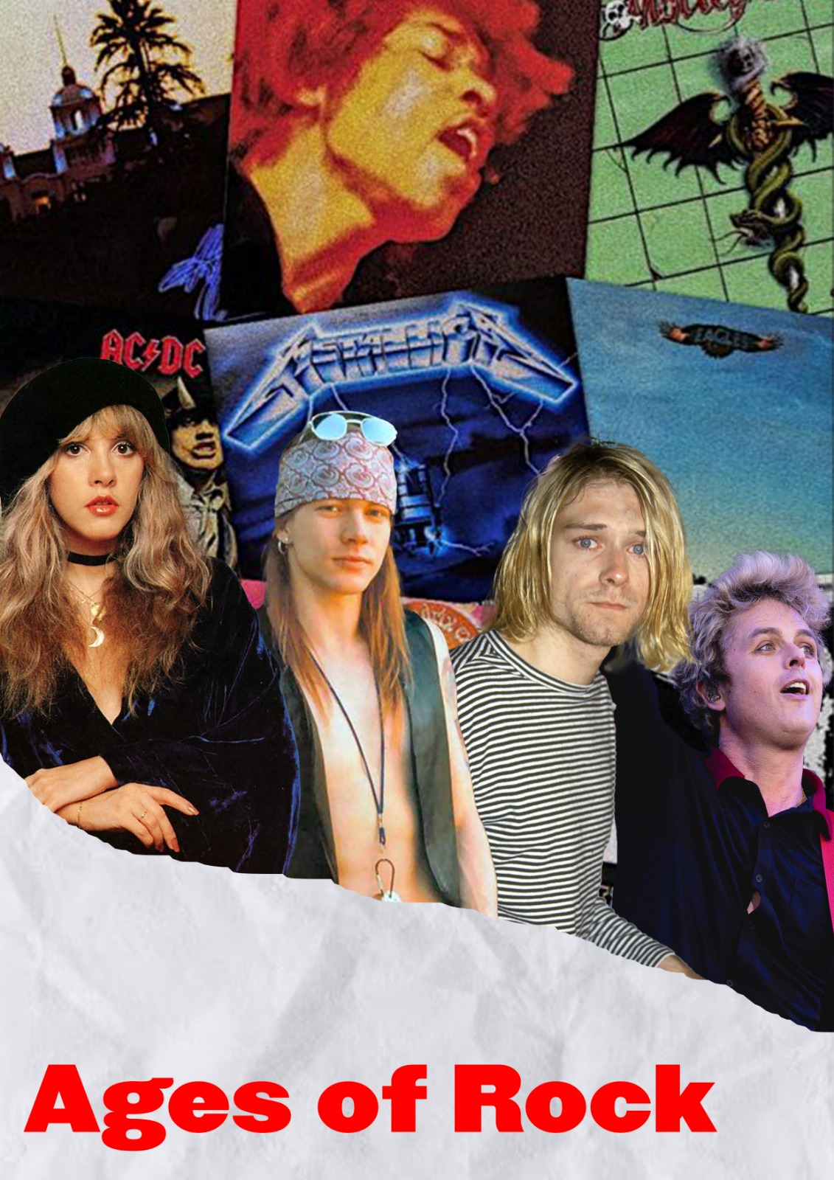
Throughout the decades music trends have changed
in different ways.
Timeframe: 70’s - 00’s Word
Topic: Perception
Context: Historical
Approach: Art/Music

Slide 3
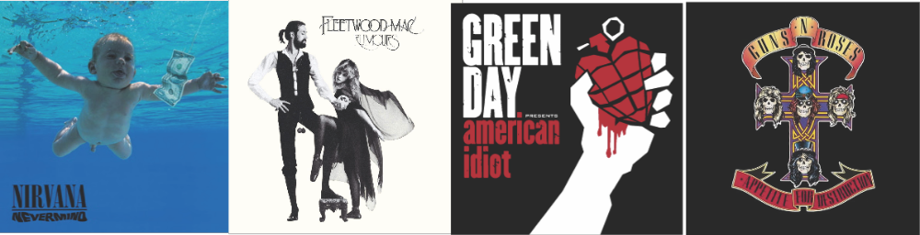
Most popular bands, genres and albums:70’s: Fleetwood mac, “Rumours”, pop-rock80’s: Guns’n’Roses, “Appetite for destruction”, hard-rock90’s: Nirvana, “Nevermind”, grunge00’s: Green Day, “American idiot”, pop-punk
All these bands have changed the perception of the world in their respective eras.

Slide 4


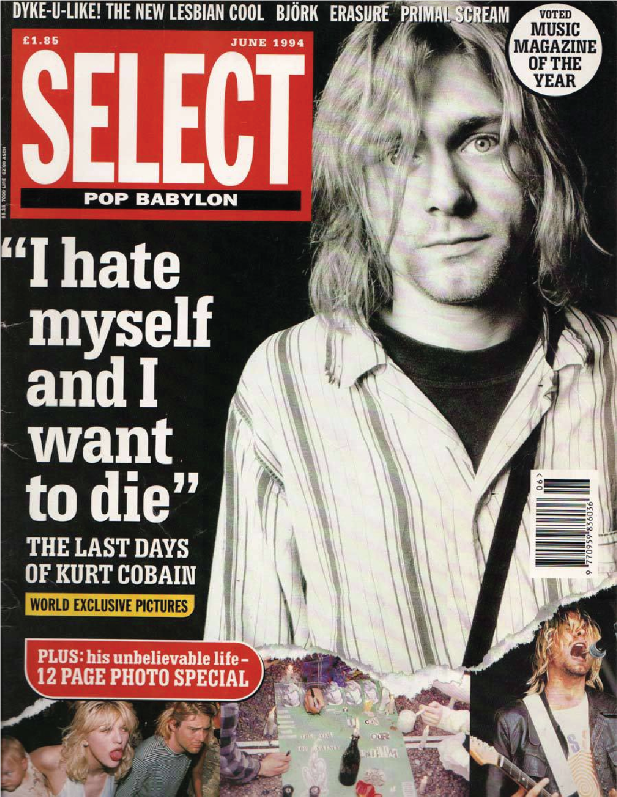
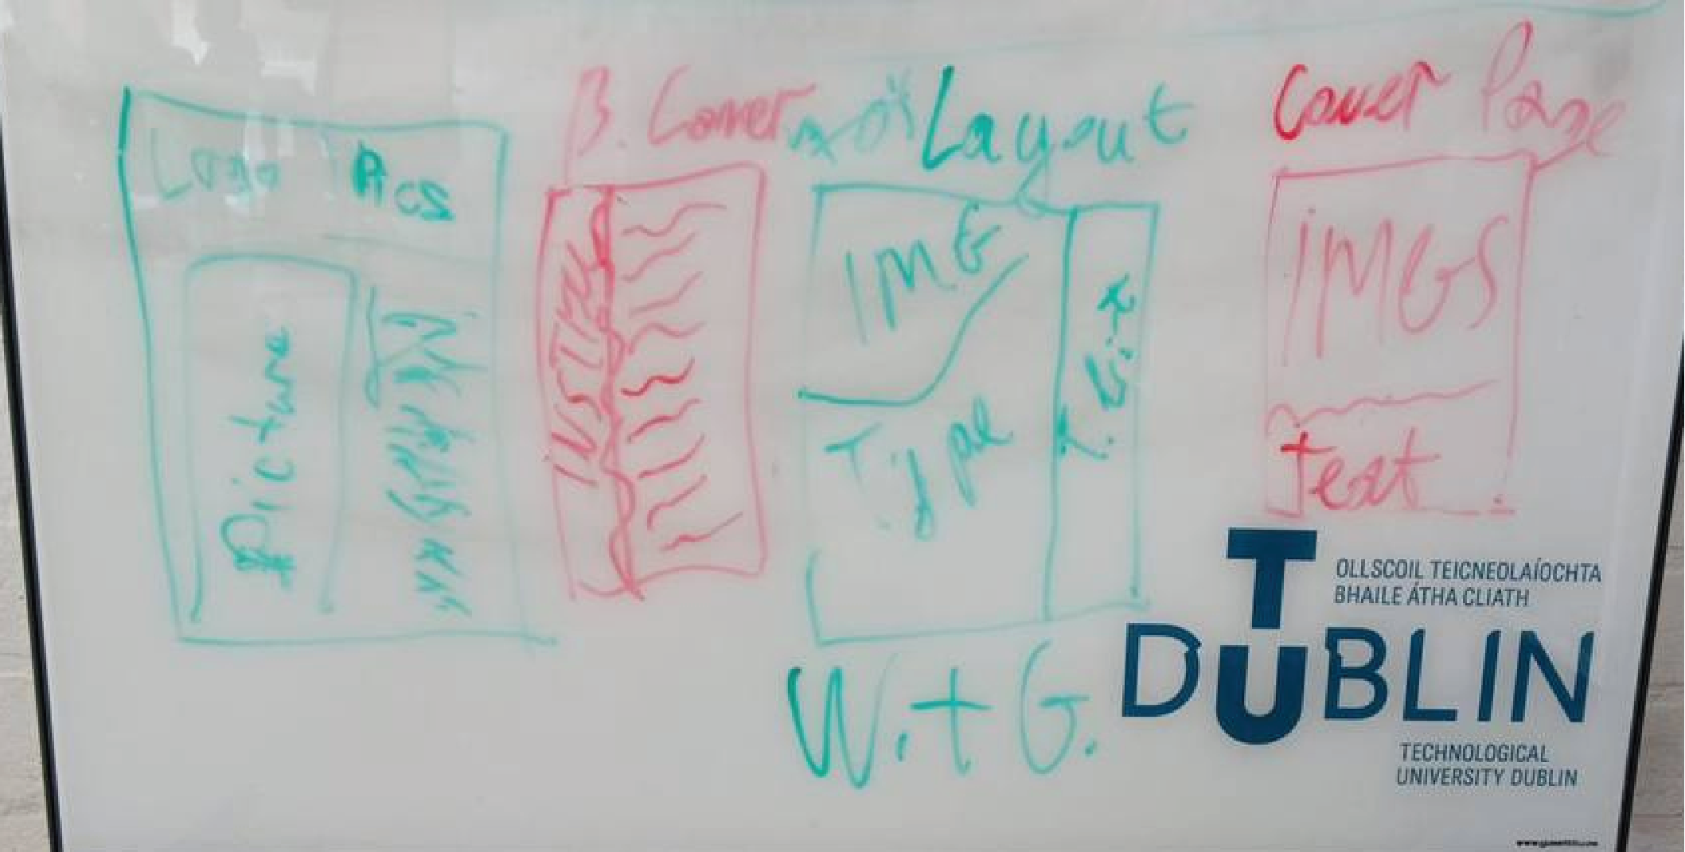

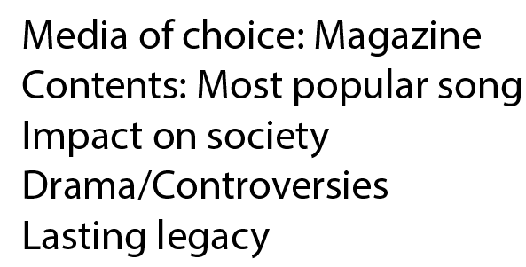

Slide 5
Visual Research:
We have conducted research on printed media of eras of interest.
Our aim is to replicate the vibe of those times
in our articles as in an article about an 80’s band would replicate 80’s print style

Slide 6
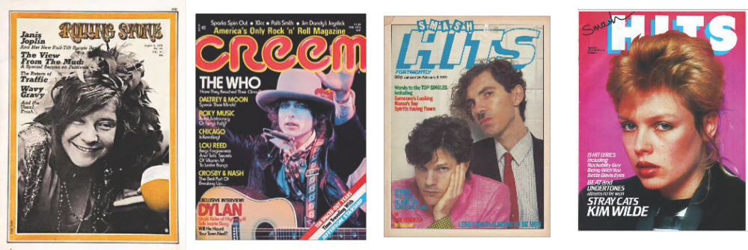
Visual Research:

Slide 7
OUR DESIGNS

Slide 8
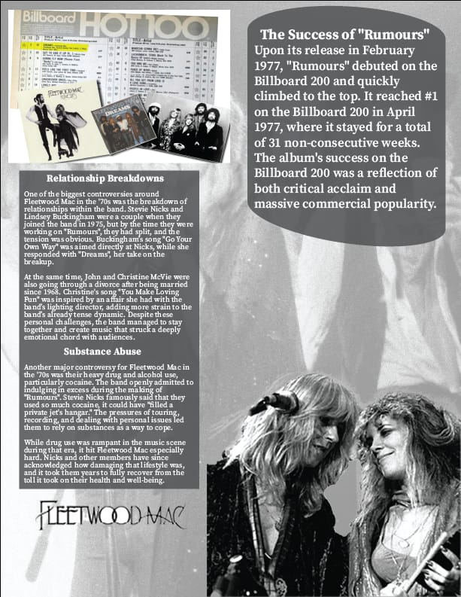
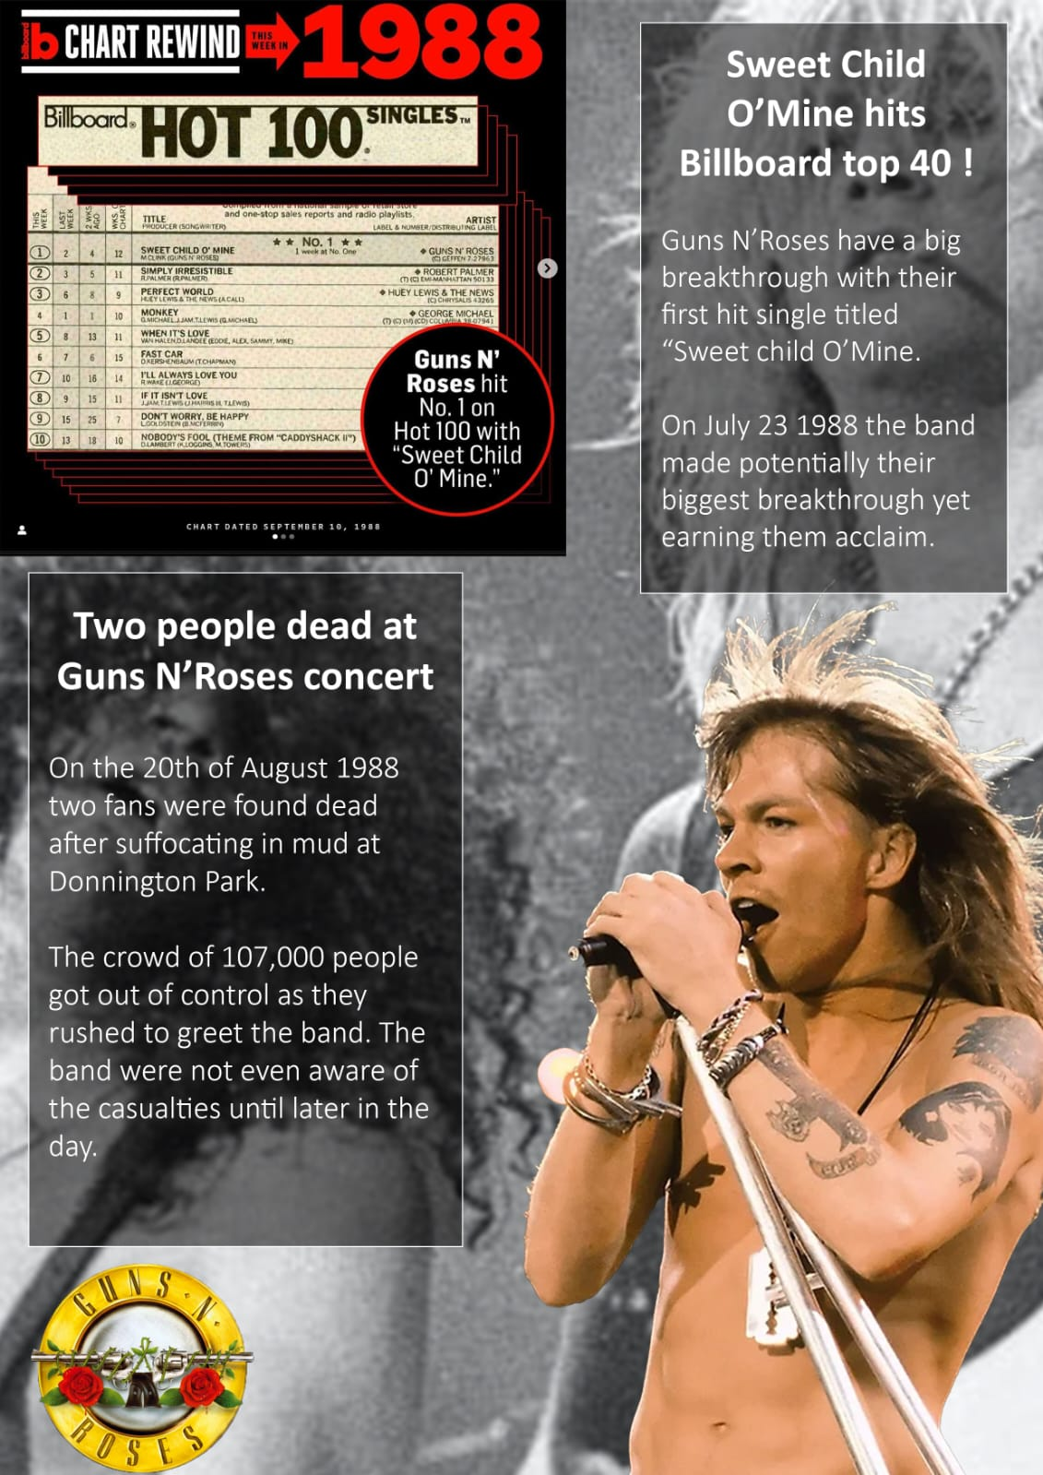

Slide 9
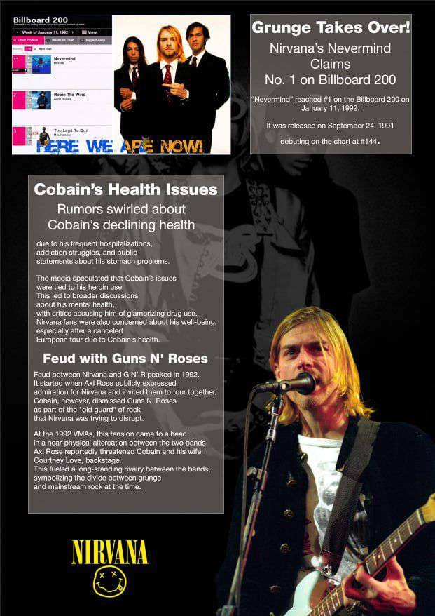
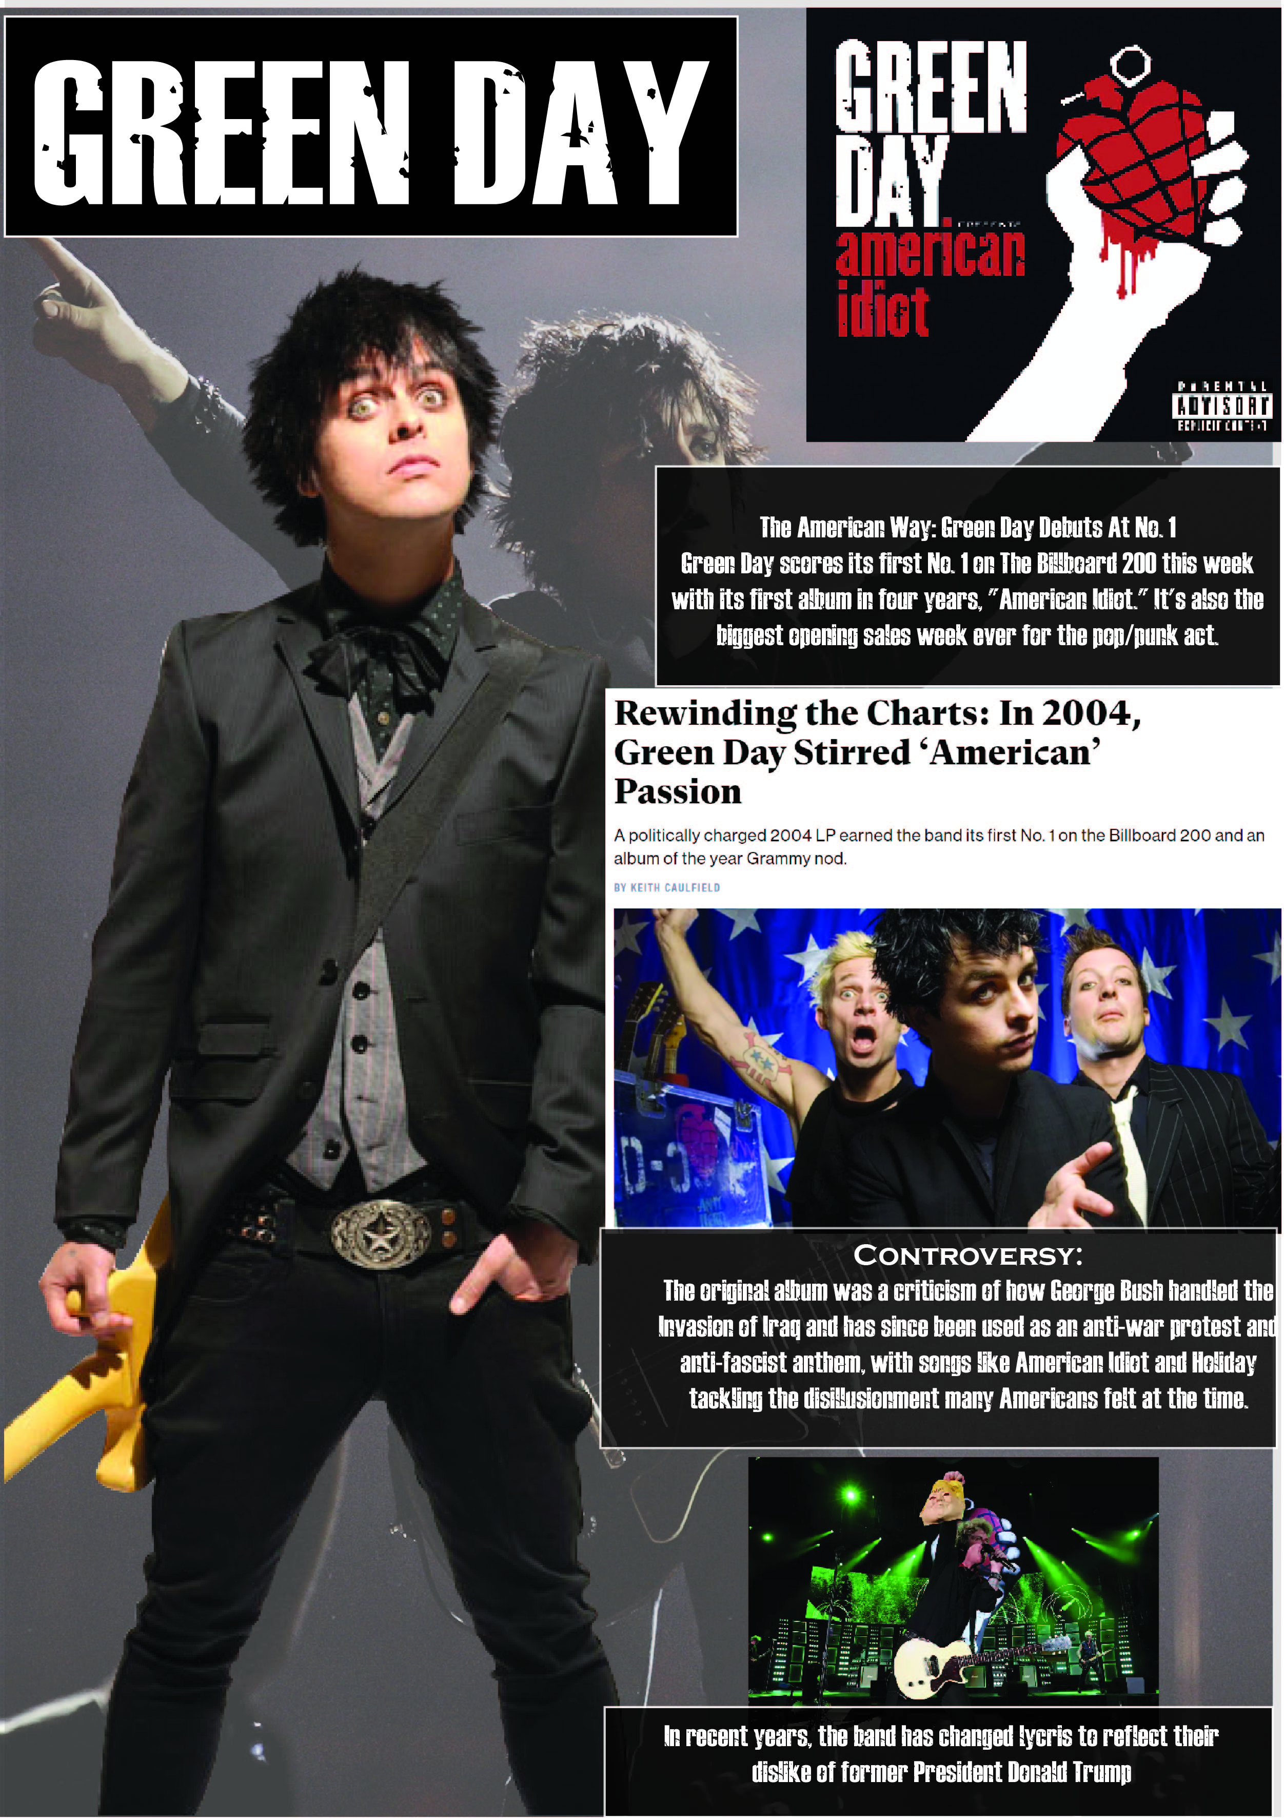

Slide 10

And the back cover:
here’s a QR code for the rock band of the 2020s.

